Slide 1
SQOOP

Slide 2
What is Apache Sqoop?
Apache Sqoop, a command-line interface tool, moves data between relational databases and Hadoop. It is used to export data from the Hadoop file system to relational databases and to import data from relational databases such as MySQL and Oracle into the Hadoop file system.

Slide 3
Why Use Sqoop?
A component of the Hadoop ecosystem is Apache Sqoop. There was a need for a specialized tool to perform this process quickly because a lot of data needed to be moved from relational database systems onto Hadoop.
This is when Apache Sqoop entered the scene and is now widely used for moving data from RDBMS files to the Hadoop ecosystem for MapReduce processing and other uses.

Slide 4
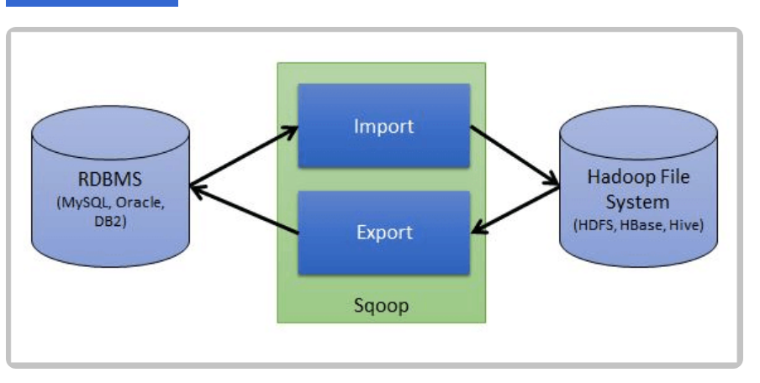
Source: https://www.freecodecamp.org/news/an-in-depth-introduction-to-sqoop-architecture-ad4ae0532583/)

Slide 5
Features of Apache Sqoop
Apache Sqoop has many essential features. Some of them are discussed here:
Sqoop uses the YARN framework to import and export data. Parallelism is enhanced by fault tolerance in this way.
We may import the outcomes of a SQL query into HDFS using Sqoop.

Slide 6
For several RDBMSs, including MySQL and Microsoft SQL servers, Sqoop offers connectors.
Sqoop supports the Kerberos computer network authentication protocol, allowing nodes to authenticate users while securely communicating across an unsafe network.
Sqoop can load the full table or specific sections with a single command.

Slide 7
Sqoop Architecture
Using its connectors, sqoop facilitates data migration between Hadoop and external storage systems. These connectors enable Sqoop to work with various widely-used relational databases, such as MySQL, PostgreSQL, Oracle, SQL Server, and DB2. Each connector establishes communication with the corresponding DBMS it is associated with.

Slide 8
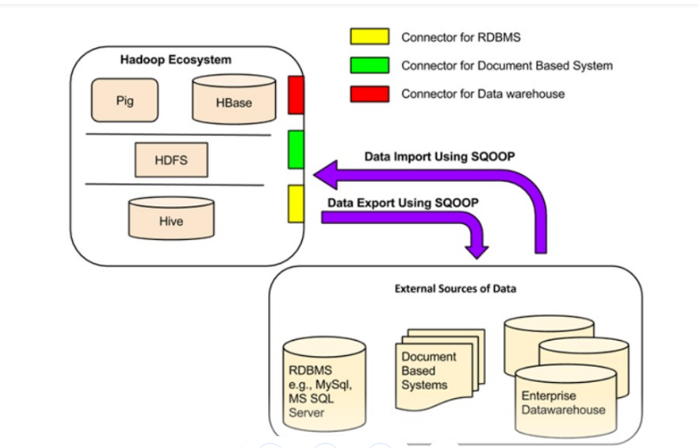

Slide 9
Sqoop working- two main operations of Sqoop:
Sqoop Import
Sqoop Export:

Slide 10
Sqoop Import :
The procedure is carried out with the aid of the sqoop import command. We can import a table from the Relational database management system to the Hadoop database server with the aid of the import command. Each record loaded into the Hadoop database server as a single record is kept in text files as part of the Hadoop framework.

Slide 11
Sqoop Export:
The Sqoop export command facilitates the execution of the task with the aid of the export command, which performs operations in reverse. Here, we can transfer data from the Hadoop database file system to the relational database management system with the aid of the export command.
Before the operation is finished, the data that will be exported is converted into records. Two processes are involved in the export of data: the first is searching the database for metadata, and the second is moving the data.

Slide 12
Advantages of using Sqoop
Using Apache Sqoop has a lot of advantages. They are:
It entails data transfer from numerous structured sources, like Oracle, Postgres, etc.
Due to the parallel data transport, it is quick and efficient.
Many procedures can be automated, which increases efficiency.

Slide 13
Integration with Kerberos security authentication is feasible.
Direct data loading is possible from HBase and Hive.
It is a powerful tool with a sizable support network.
As a result of its ongoing development and contributions, it is frequently updated.

Slide 14
Limitations of Using Sqoop
1. Apache Sqoop cannot be stopped or started again.
2. The hardware setup of the RDBMS server affects how well the Sqoop Export performs.
3. Sqoop is slow since the backend processing uses the MapReduce model.
4. Special handling is required for partial import and export failures.
5. Apache Sqoop offers larger connectors for a few of the databases.

Slide 15
Summary
Sqoop is used in the Hadoop cluster.
HDFS receives data imports from RDBMS or NoSQL databases.
The data is loaded into HDFS after being divided into several forms using mappers.
Sqoop exports data back into the RDBMS while ensuring the database’s data schema is maintained and followed.

Slide 16
Importing a single table:
sqoop import \
--connect jdbc:oracle:thin:@//hostname:port/service_name \
--username your_username \
--password your_password \
--table table_name \
--target-dir /path/to/target_directory \
--as-textfile

Slide 17
sqoop import --connect jdbc:oracle:thin:@//example.com:1521/ORCL --username my_username --password my_password --table employee --target-dir /user/hadoop/employee_data --as-textfile

Slide 18
Exporting data
Exporting data using Sqoop involves transferring data from Hadoop, typically stored in HDFS, to a relational database. Below is an example of how you can export data from HDFS to an Oracle database using Sqoop:

